Slide 1
Crop production in India
Project by: Amit Malik(200548660)
Viraj(200556743)
Khushi(200513507)
Manpreet(200512610)

Slide 2
Objective
The aim of this project is to perform Exploratory Data Analysis on the “Crop production in India" dataset. This involves retrieving the data from a remote URL, storing it in a MongoDB database. Furthermore, the project seeks to leverage Google Charts to create insightful visualizations that aid in the interpretation and analysis of the data.

Slide 3
Dataset Description
URL:- https://india-crop.s3.us-east-2.amazonaws.com/crop_production.csv
The dataset contains a set of 246092 rows under 7 attributes (measures and categories/dimensions)
Few Measures found in the dataset are with their ranges:
State_Name: Name of the state (Andaman and Nicobar Islands)
.District_Name: Name of the district within the state.
Crop_Year: Year of crop production (2000 or 2001).
Season: Season of crop production (Kharif or Whole Year).
Crop: Type of crop produced.
Area:Total area (in hectares) on which the crop was produced.
Production: Total production (in quintals) of the crop in the given area

Slide 4
Our Team
Amit Malik (Developer):- Developing both the front-end and back-end components of the application, and also played a key role in implementing cloud infrastructure to support the application.
Viraj (Project Lead):-responsible for overseeing the project deliverables and ensuring they were completed on time, and also provided support in the documentation process.
Khushi (Data Analyst):-Responsible for obtaining the necessary data, constructing the database, and collaborated with the developer to create various visualizations based on the data.
Manpreet (Business Analyst):-Contributed to the project proposal by creating detailed documentation, and also assisted the data analyst in developing visualizations based on the data

Slide 5
Programming Languages and Cloud Infrastructures
Python Programming Language
Flask Framework
Html & CSS
Amazon S3
MongoDB: Database

Slide 6
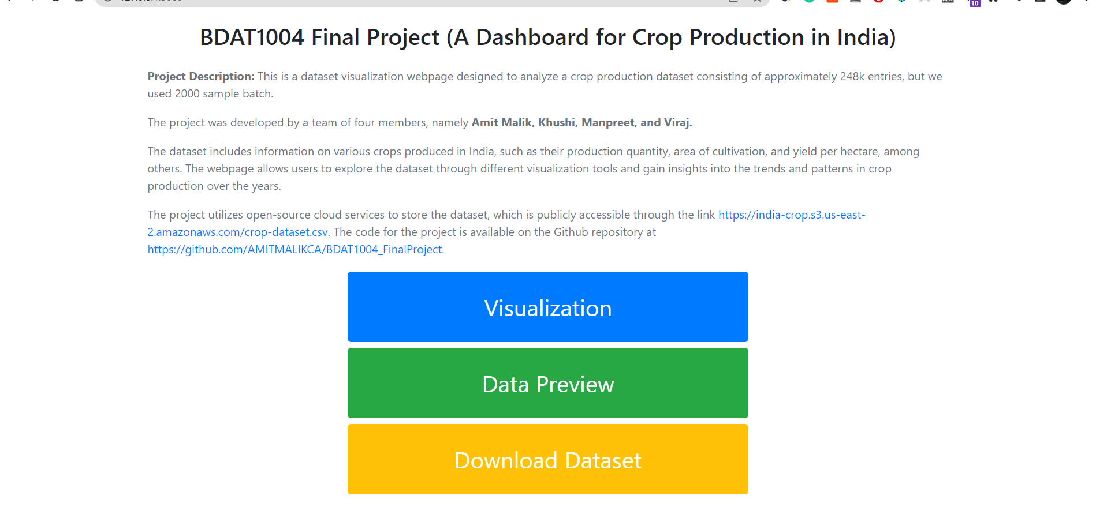
Home Page

Slide 7
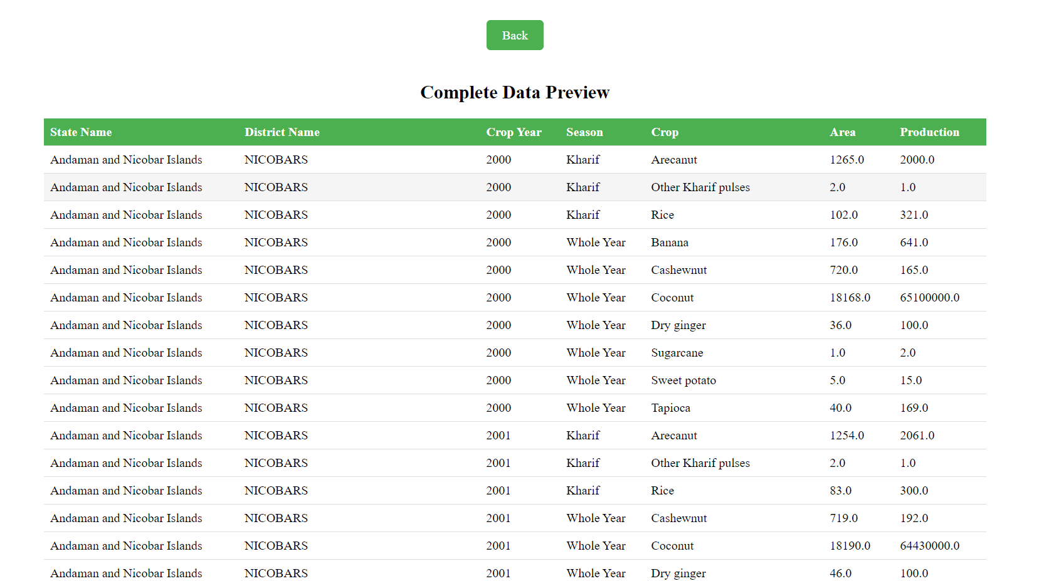
Data Preview

Slide 8
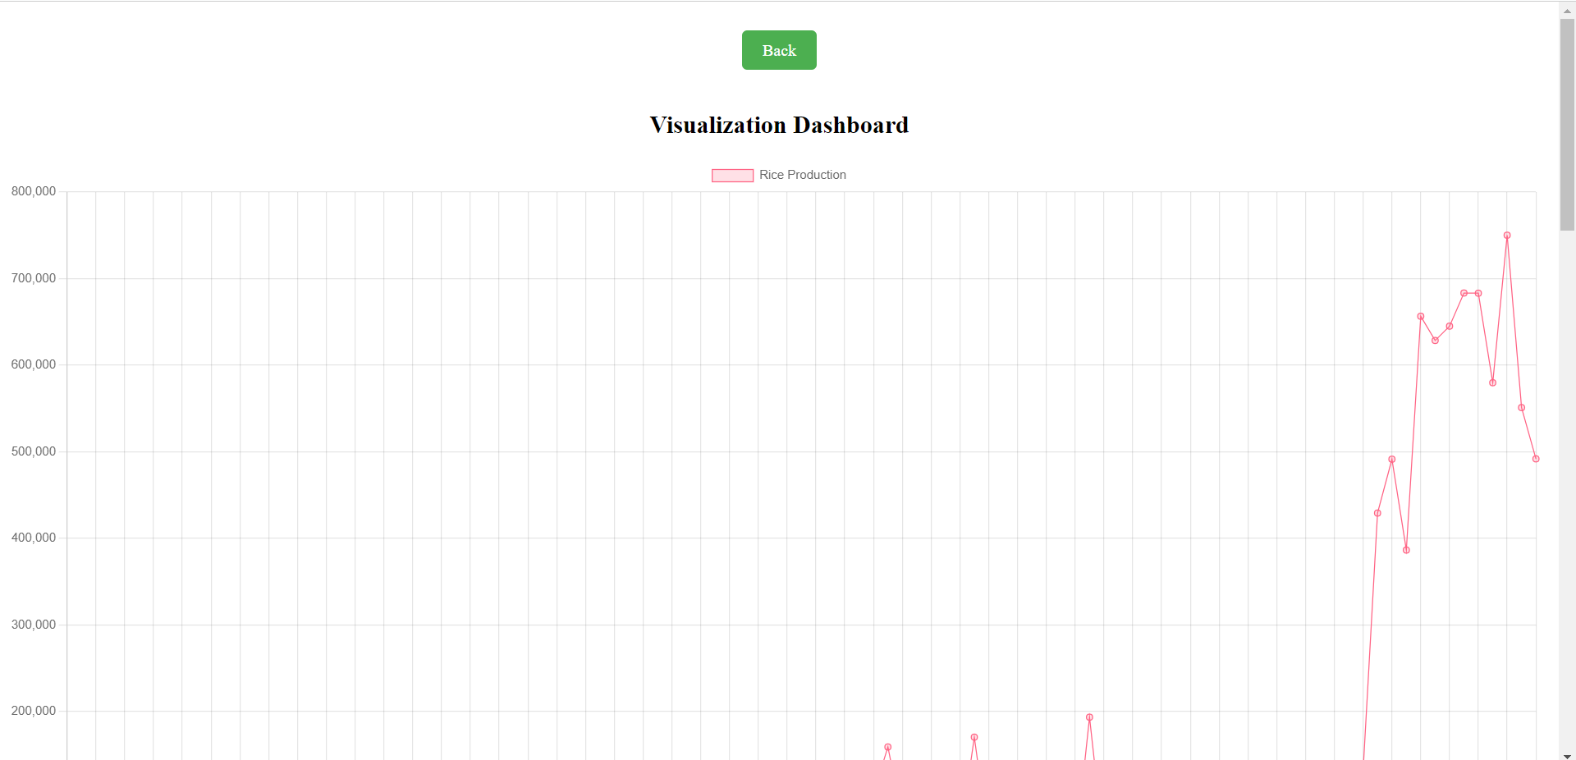
Visualization of Rice Production

Slide 9
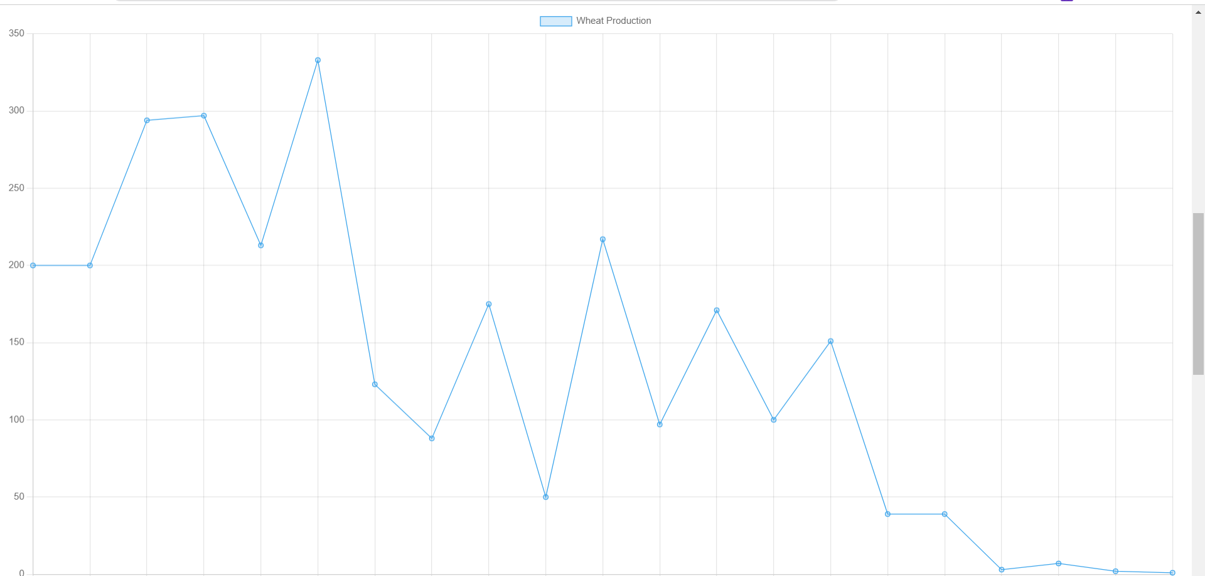
Visualization of Wheat Production

Slide 10
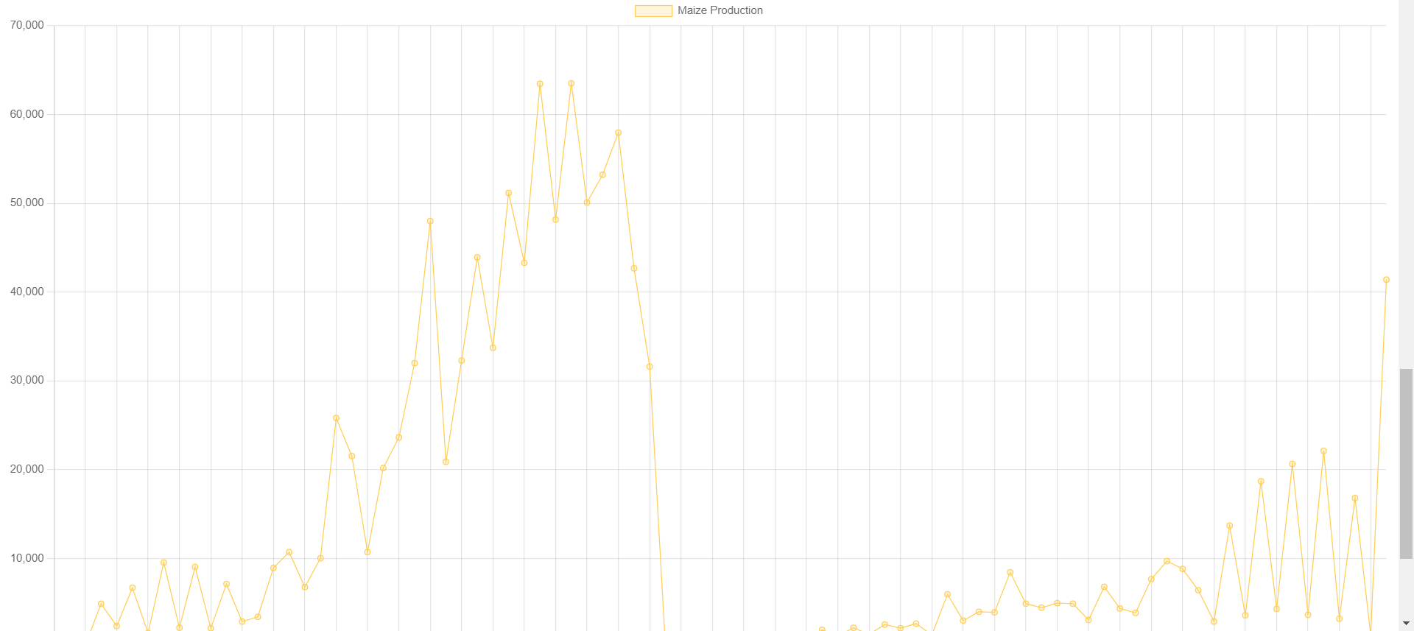
Visualization of Maze Production

Slide 11
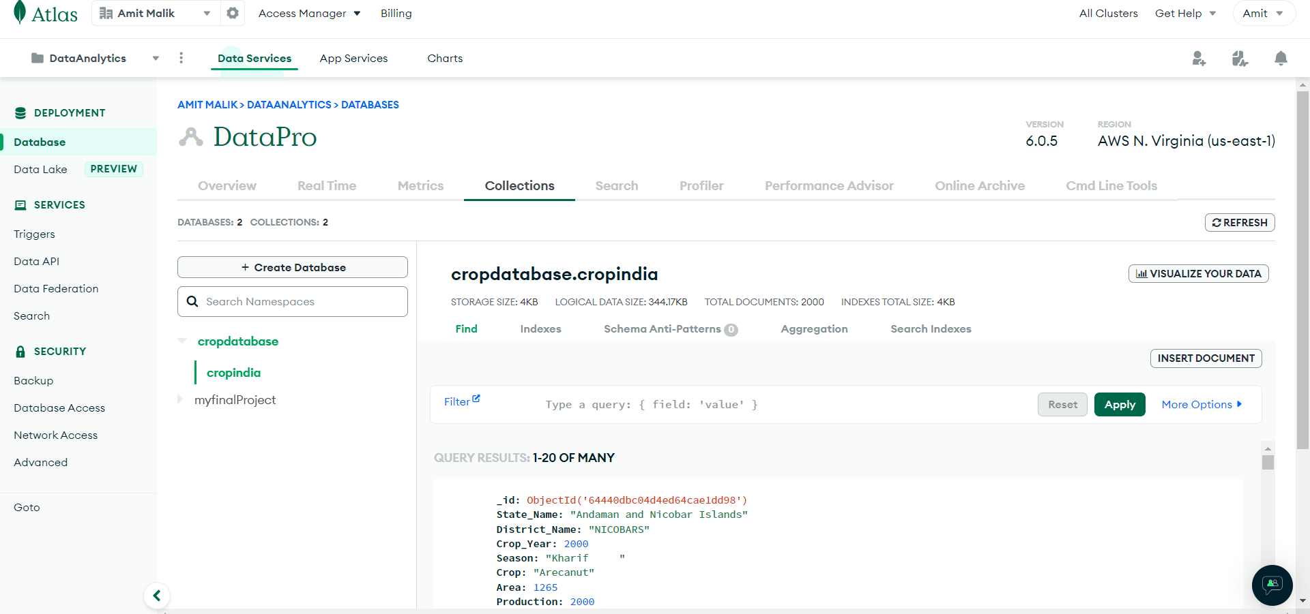
MongoDB Database

Slide 12
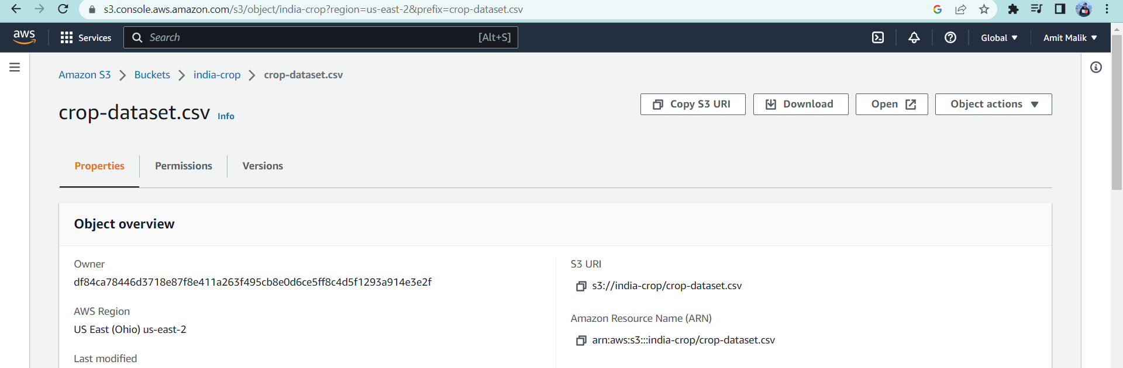

Slide 13
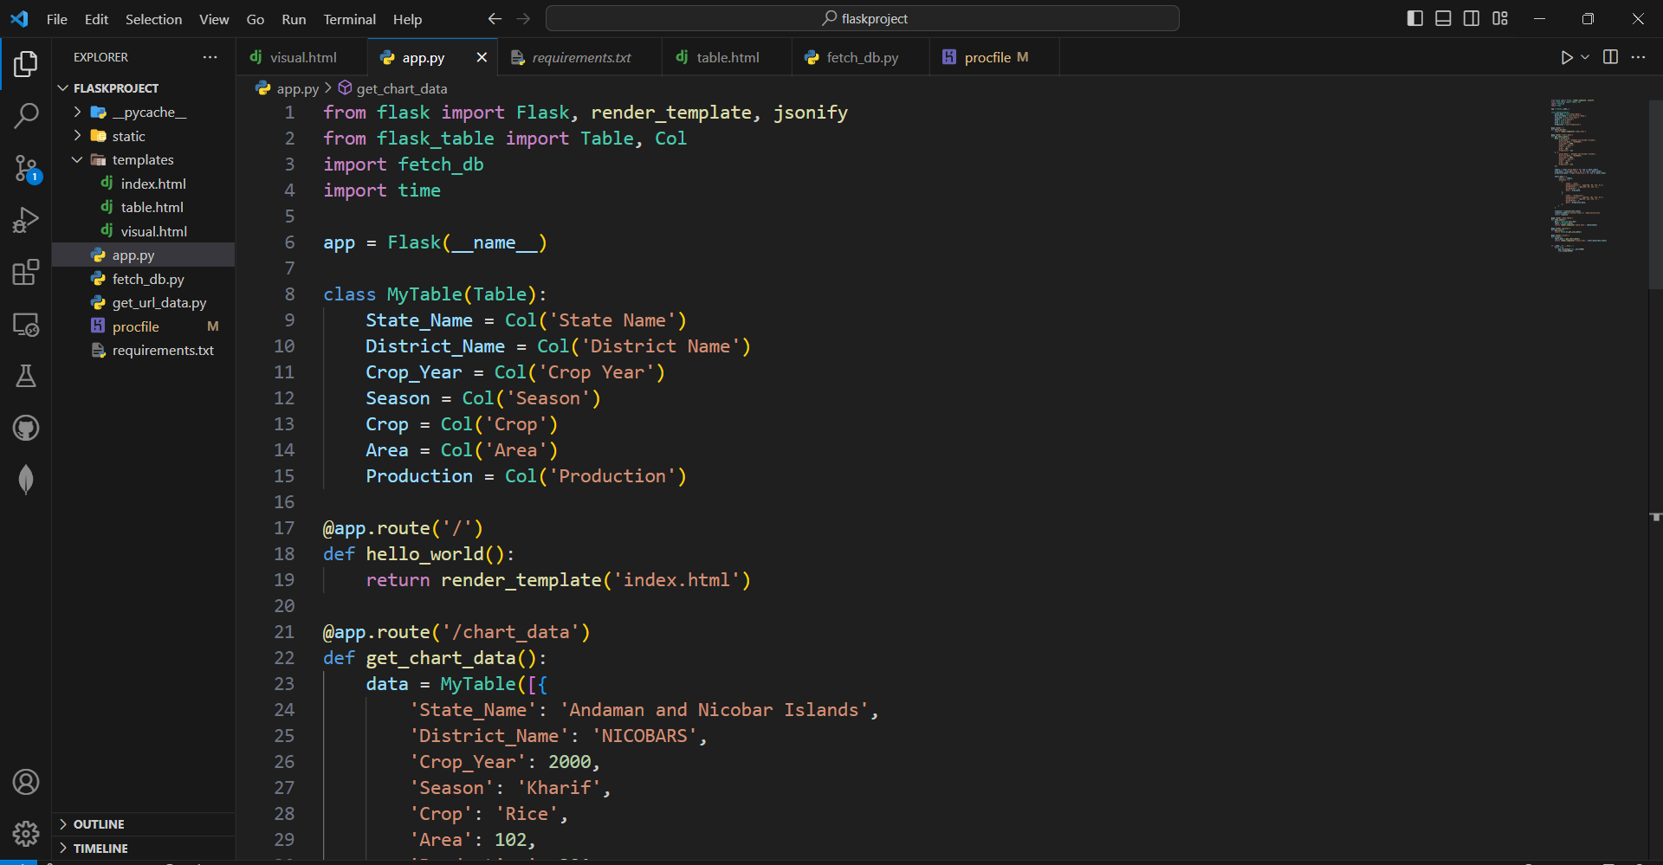
FlaskApp

Slide 14
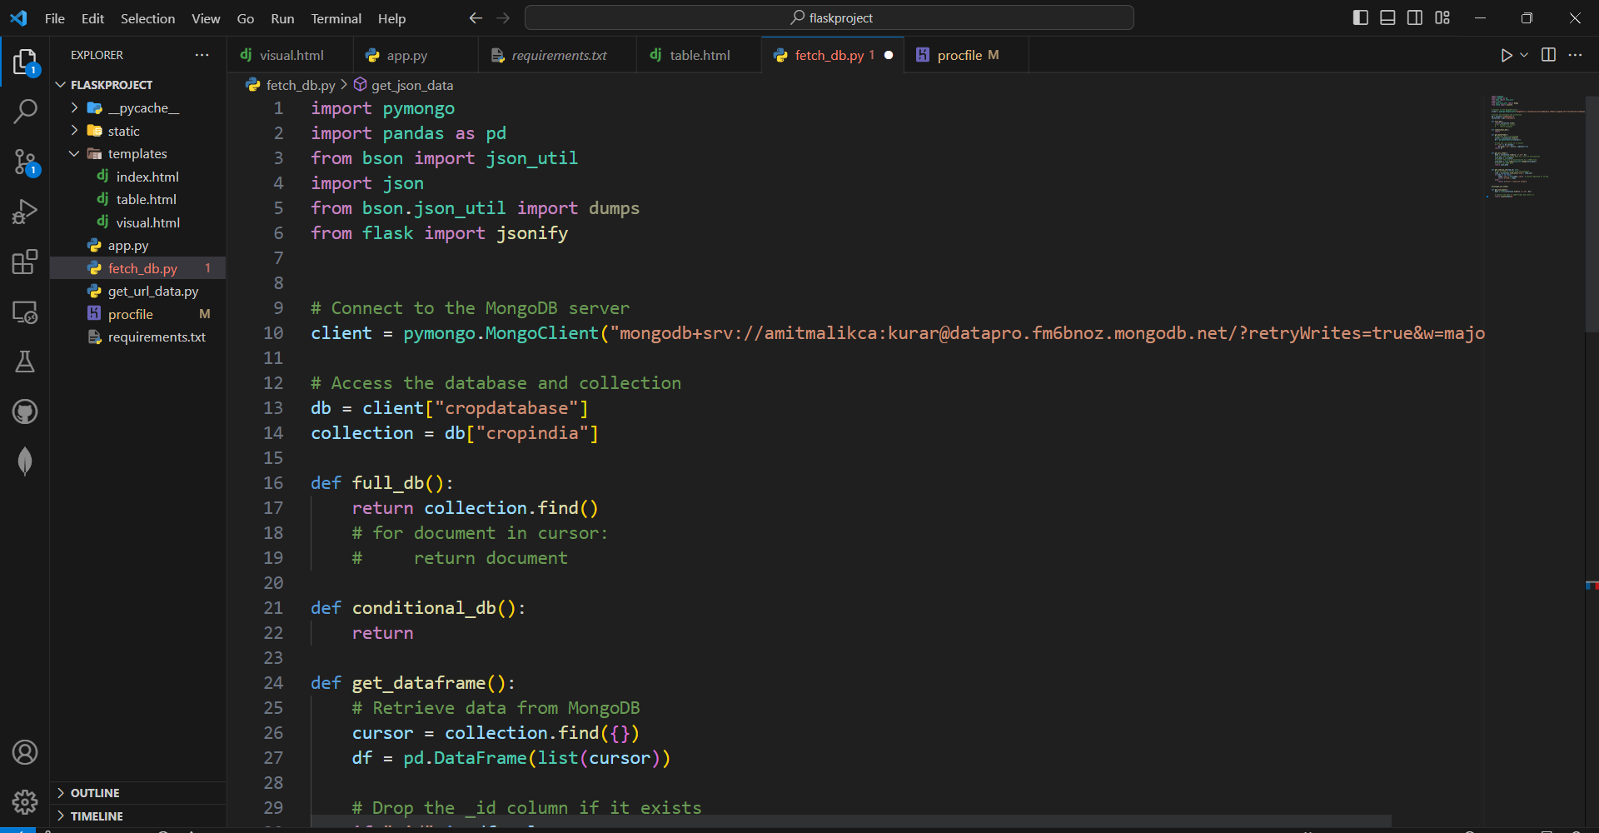
Data to Fetch Data from MongoDB

Slide 15
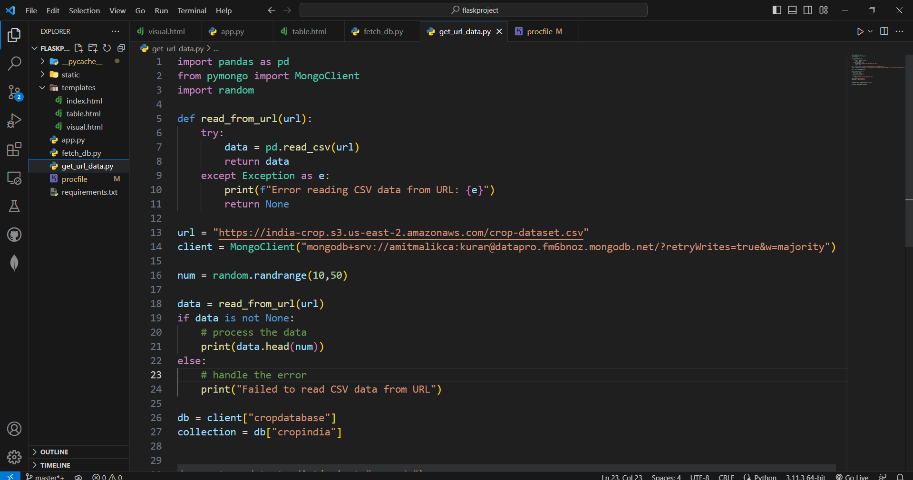
Code to Render Data from Open Url & Store in Database

Slide 16

Conclusion
To summarize, this project has utilized the “Crop production in India" dataset to conduct Exploratory Data Analysis by retrieving and storing the data in MongoDB. Additionally, Google Charts has been utilized to create visually appealing and informative data visualizations. Overall, the project has successfully achieved its objective of analyzing the “Crop production in India" dataset and presenting the insights in an accessible manner. This project can serve as a valuable reference for individuals and organizations seeking to explore and visualize large datasets using advanced data analysis methods and tools.

